Slide 1
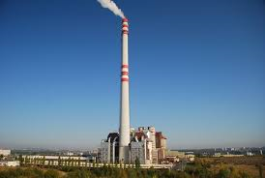
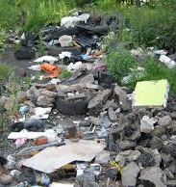
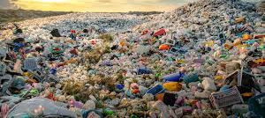
INCINERATION PLANTS AND LANDFILLS IN THE CR, WASTE AND ECOLOGY
TEAM PORTUGAL : ANNA BALAŠTÍKOVÁ, ADÉLA FORSTOVÁ, JOHANA MRÁČKOVÁ, JAROSLAV VOJÁČEK, FILIP VYSLOUŽIL

Slide 2
Incineration plants
•each batch is always checked and sorted first.
•The waste is removed for recycling.
•OTHER THINGS ARE BURNT AS WELL.
•NOT many incineration plants

Slide 3
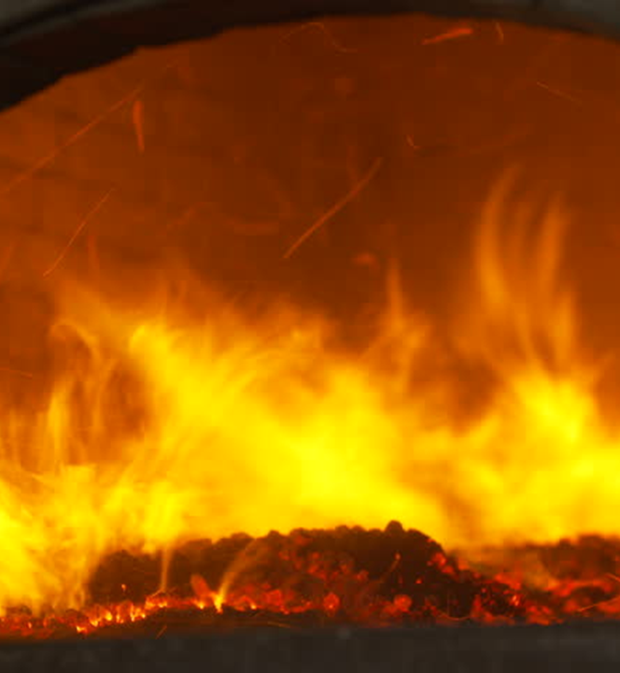
77,000 TONS
850 – 1100 °C
1876
1905

Slide 4
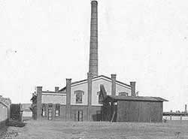
INCENERATION PLANTS IN THE CZECH REPUBLIC
THE FIRST ONE WAS BUILT IN 1905 IN BRNO, IT WAS DESTROYED AND NEVER REBUILT

Slide 5
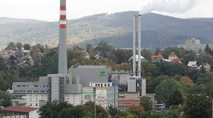
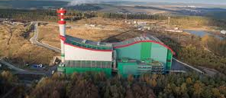
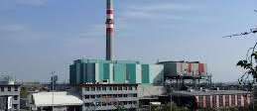
PRAGUE
PLZEŇ
BRNO
LIBEREC

Slide 6
A MAP OF INCENERATION PLANTS IN THE CZECH REPUBLIC

Slide 7
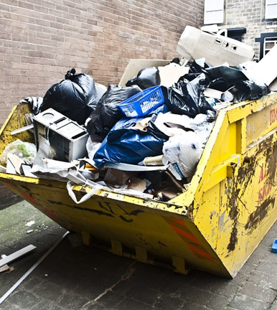
WASTE DISPOSAL

Slide 8
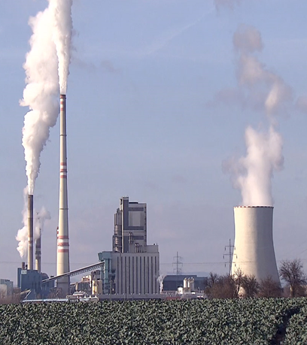
TYPES OF WASTE THAT END UP IN INCINERATION PLANTS
THREE TYPES OF WASTE FOR INCINERATION
​
SOLID WASTE
HAZARDOUS WASTE
MEDICAL WASTE

Slide 9
ECOLOGY
ECOLOGY IS MODERN, BUT VERY IMPORTANT

Slide 10
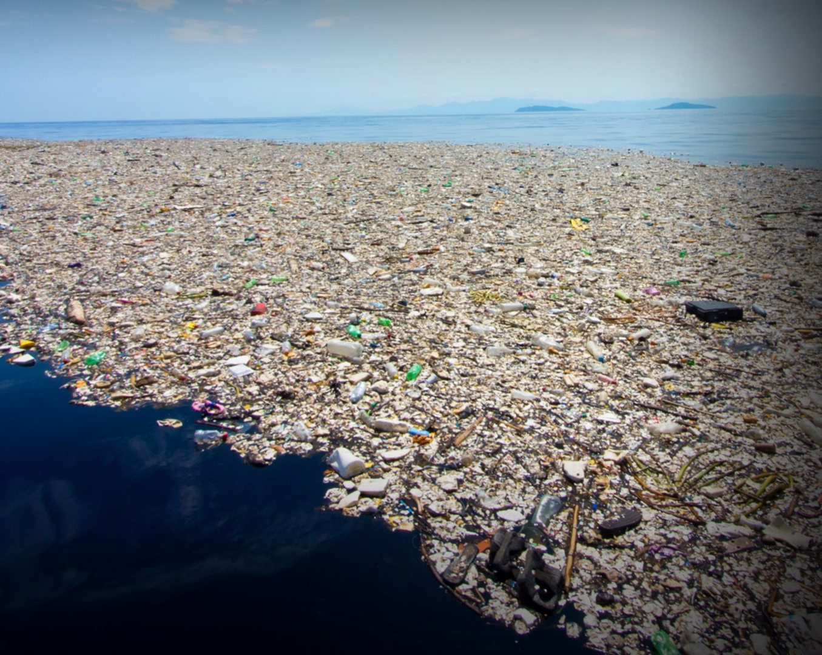
WASTE

Slide 11
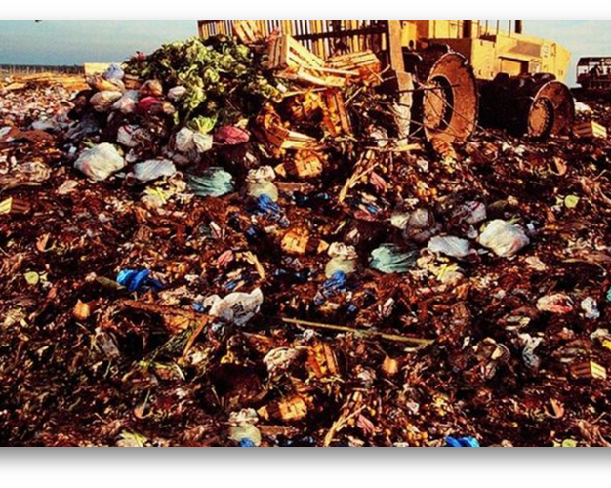
BLACK DUMPS (FLY TIPPING)

Slide 12
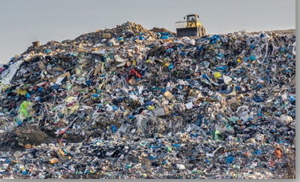
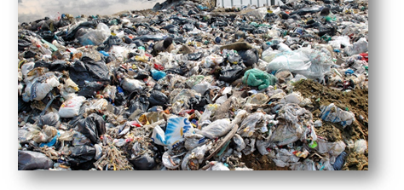
BLACK DUMPS IN CZECH REPUBLIC

Slide 13
THANK YOU FOR YOUR ATTENTION

Slide 14
SOURCES:
http://www.odpadjeenergie.cz/vyroba-energie/zarizeni-evo-v-cr/kde-se-u-nas-vyrabi-energie-z-odpadu
https://woimacorporation.com/drowning-in-waste-case-vietnam/
https://www.mpul.cz/cerne-skladky.html
https://www.sako.cz/pro-brnaky/cz/142/historie-spalovani/
https://www.sako.cz/pro-brnaky/cz/256/spalovna-zarizeni-na-energeticke-vyuzivani-komunalniho-odpadu/
https://www.cistaplzen.cz/o-odpadu-v-plzni/finalni-zpracovani-odpadu/spalovna/
https://cs.wikipedia.org/wiki/Spalovna
https://ekolist.cz/cz/zpravodajstvi/zpravy/spalovna-v-liberci-provoz-obnovi-provoz-nejdriv-v-rijnu
https://genus.cz/regiony/jablonecko/po-zmirneni-vladnich-narizeni-v-souvislosti-s-koronavirem-se-v-sobotu-otevre-sberny-dvur-na-proseci-n478085.htm
https://www.ceskatelevize.cz/porady/1095913550-nedej-se/218562248410036-konec-spaloven-v-cechach/
https://www.shutterstock.com/cs/image-vector/ecology-icon-set-concept-green-energy-764769286
https://www.circular-solutions.eu/news/how-venture-capital-can-help-stem-the-flow-of-ocean-plastic-waste/
https://www.e15.cz/magazin/aplikace-tvorena-uzivateli-likviduje-cerne-skladky-1038973
https://zpravy.aktualne.cz/domaci/snemovna-podporila-novy-odpadovy-zakon/r~3ed7b332442411ea9b40ac1f6b220ee8/
https://domaci.ihned.cz/c1-66818290-konec-skladkovani-bude-az-v-roce-2030-schvalila-snemovna-za-odpad-se-ale-budou-zvysovat-poplatky
https://ekolist.cz/cz/zpravodajstvi/zpravy/konec-skladkovani-odpadu-se-zrejme-posune-o-sest-let-na-rok-2030
https://lase-solutions.com/products/mining/lasewvi-waste-volume-incinerator/
https://www.shutterstock.com/cs/video/clip-1020680704-industrial-incinerator-fire-slow-motion-video
https://act-adapt.org/13-mind-blowing-images-of-landfills-around-the-world-show-the-true-cost-of-our-waste/http://cvitanic.info/smile/

