Slide 1
Recycling
Recycling is defined by European Union Directive n. 98/2008:
Any recovery operation by which waste is reprocessed into products, materials or substances whether for the original or other purposes. It includes the reprocessing of organic materials, but does not include energy recovery and reprocessing into materials to be used as fuel or as backfill material.
EU Directive n. 98/2008, Article 3
Notes:
Představit se pořadí David, Filip, Jindra, Nikos, Honza
Jindra čte slide 1 a 2
David: We want to talk to you about recycling. What is recycling?

Slide 2
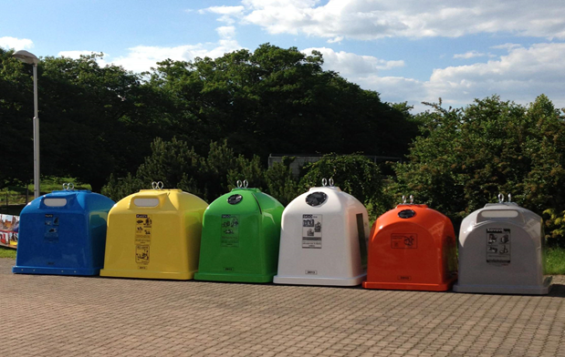
The most important goal of the new legislation
- to increase the sorting and recycling of waste
- to recycle 55% of all municipal waste
- at present only in 39% of the municipal waste is recycled
Notes:
Nikosovo

Slide 3
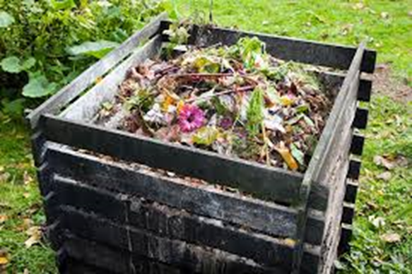
Popularity of recycling in Czech Republic
73 % of the population recycles
The Czech Republic ranks 5th in plastic recycling in the EU
In CZ paper is easily recycled
THE MOST POPULAR ITEMS TO RECYCLE:
Plastics, glass
Electrical waste
Metals
BIO waste
used cooking oils and fats
Notes:
Nikosovo

Slide 4
Notes:
David: And now, we want to talk about recycling codes, here in Czech Republic. Can you introduce them?, Honza.
Honza: Ok! Picture one is a logo, of a company EKO-KOM, wich specializes in recycling. Picture two means that a product could be recycled. Picture three shows the recycling process.

Slide 5
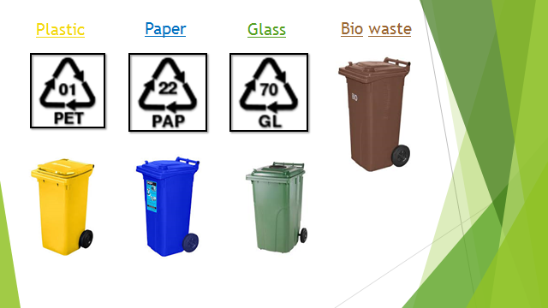
Notes:
Honza: Many things can be recycled, each has its own colour code.

Slide 6
Notes:
Honzovo
David: Where woudl you trow away a rotten apple?
Honza: In to the bio waste bin.
David: Where woudl you trow away a broken TV?
Honza: In to the electrical waste.
Honza See? Its easy!

Slide 7
Dumps in the Czech Republic
In the Czech Republic there are 2 kinds of dumps
Legal dumps
Illegal dumps
Notes:
Davidovo (slide 8 a 9)

Slide 8
Cost for dustbins
Average cost for a person per year is 500 CZK (18 euro).
Children do not pay.
Cost for dustbins steadily rises, because of the people, who don‘t separate rubbish.

Slide 9
Upcycling and Downcycling in the Czech Republic
Notes:
Filipovo XD 420 69

Slide 10
Downcycling
The process by which a product is converted into a lower quality product during recycling
Examples of Downcycling
High quality wood > Hardboard > Biomass
Paper > Toilet paper
Symbol of downcycling

Slide 11
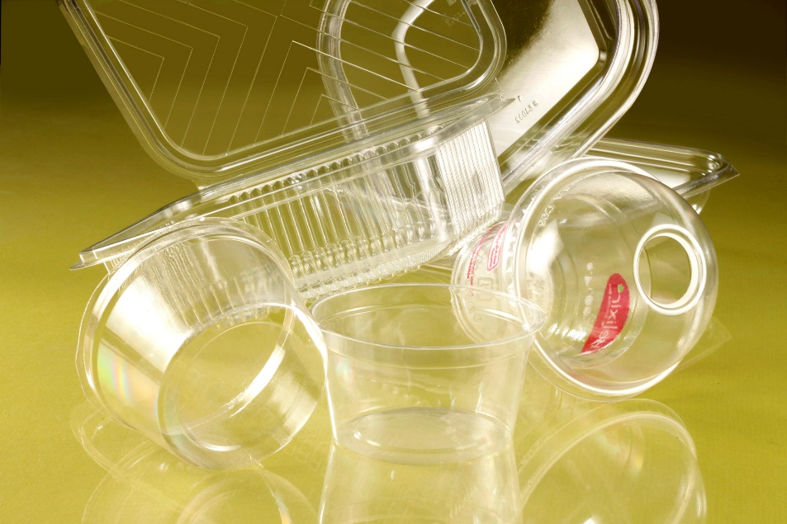
Upcycling The process by which a product is converted into a higher quality product during recycling
Bioplastics
Upcycling symbol

Slide 12
Thank you for your attention
DO YOU HAVE ANY QUESTIONS?

Slide 13
Sources
Source: Wikipidea articles: https://cs.wikipedia.org/wiki/Recyklace, https://cs.wikipedia.org/wiki/Downcycling, https://cs.wikipedia.org/wiki/Upcyklace
Source: photos: https://www.google.com/url?sa=i&url=https%3A%2F%2Fwww.lornestewartgroup.com%2Fuploads%2FLSE%2520responsibility%2F&psig=AOvVaw1bUzwiDYfRvLzkHYaMXRGm&ust=1609938741860000&source=images&cd=vfe&ved=0CAIQjRxqFwoTCIj75qfvhO4CFQAAAAAdAAAAABAE,
https://www.google.com/url?sa=i&url=https%3A%2F%2Fmeteobox.cz%2Fzpravy%2F523143-cesko-ceka-velka-odpadkova-revoluce-vlada-dnes-schvalila-novou-odpadovou-legislativu%2F&psig=AOvVaw0snqog_rfZwicd5jDRdxXw&ust=1609938845391000&source=images&cd=vfe&ved=0CAIQjRxqFwoTCPCFytrvhO4CFQAAAAAdAAAAABAD
https://www.google.com/url?sa=i&url=https%3A%2F%2Fatendimento.sebrae-sc.com.br%2Finteligencia%2Frelatorio-de-inteligencia%2Fcompostagem&psig=AOvVaw0UariYt38jD5r4HFpplemD&ust=1609938942830000&source=images&cd=vfe&ved=0CAIQjRxqFwoTCNjR0IjwhO4CFQAAAAAdAAAAABAD,
https://www.google.com/url?sa=i&url=https%3A%2F%2Fwww.cez.cz%2Fwebpublic%2Ffile%2Fedee%2Fospol%2Ffileexport%2Fo-spolecnosti%2Fpro-dodavatele%2Fskoleni_dodavatelu_ke%2Fprezentace%2F2018%2F03_ozp_evd_2018.pdf&psig=AOvVaw1RLiLedOTZ3SoAYwyzc7n4&ust=1609939169571000&source=images&cd=vfe&ved=0CAIQjRxqFwoTCOid2PXwhO4CFQAAAAAdAAAAABAD,
https://www.google.com/imgres?imgurl=https%3A%2F%2Flookaside.fbsbx.com%2Flookaside%2Fcrawler%2Fmedia%2F%3Fmedia_id%3D446175355740368&imgrefurl=https%3A%2F%2Fwww.facebook.com%2Fkejzlice%2Fposts%2Finformace-ts-humpolecsvoz-komun%25C3%25A1ln%25C3%25ADho-odpadu-popelnic-kter%25C3%25BD-pravideln%25C4%259Bprob%25C3%25ADh%25C3%25A1-v-%2F446175355740368%2F&tbnid=kscuq6KbNKErVM&vet=12ahUKEwiHzoGZ8YTuAhVPlxoKHcFED6EQMygCegQIARBC..i&docid=9KAFcGX0C4GepM&w=620&h=328&itg=1&q=popelnice%20s%20odpadky&hl=cs&ved=2ahUKEwiHzoGZ8YTuAhVPlxoKHcFED6EQMygCegQIARBC
https://www.google.com/url?sa=i&url=https%3A%2F%2Ffr.wikipedia.org%2Fwiki%2FFichier%3ADowncycling_symbol.svg&psig=AOvVaw1_4Qvfj95pvkcxwr6sC0_W&ust=1609939482028000&source=images&cd=vfe&ved=0CAIQjRxqFwoTCLizkYnyhO4CFQAAAAAdAAAAABAD, https://www.svetbaleni.cz/wp-content/uploads/2016/11/TOTALPR023a.jpg, https://cdn.pixabay.com/photo/2013/07/13/12/09/recycle-159282_1280.pn
https://www.google.com/url?sa=i&url=http%3A%2F%2Fnerahnuti.cz%2Fbananove-slupky-k-ruzim-rossmann-jede-blesi-trhy-a-kompostuj-cz%2F&psig=AOvVaw3eyavdQrZbogjNGay__UiG&ust=1610445659169000&source=images&cd=vfe&ved=0CAIQjRxqFwoTCLCMi-rPk-4CFQAAAAAdAAAAABAK

Slide 14
https://www.google.com/url?sa=i&url=https%3A%2F%2Fwww.samosebou.cz%2F2018%2F04%2F11%2Fvse-o-recyklacnich-symbolech-na-obalech%2F&psig=AOvVaw0ez7G_B05s01mscDBHk_B3&ust=1610446067498000&source=images&cd=vfe&ved=0CAIQjRxqFwoTCPjjsqHRk-4CFQAAAAAdAAAAABAD
https://www.google.com/url?sa=i&url=https%3A%2F%2Fcs.wikipedia.org%2Fwiki%2FRecyklace&psig=AOvVaw2X0BcqsHxolfyZWSrMvits&ust=1610446253921000&source=images&cd=vfe&ved=0CAIQjRxqFwoTCMCfs_nRk-4CFQAAAAAdAAAAABAD
https://www.google.com/url?sa=i&url=https%3A%2F%2Fwww.kupsito.sk%2Fi%2F9464920791%2FKo%25C5%25A1e_popoln%25C3%25ADky%2FKO%25C5%25A0%25C3%258DK_NA_KONTAJNER_NA_ODPADY_EUROPLAST_%25C5%25BDLT%25C3%259D_120L&psig=AOvVaw1kUM-_YORv_Dm2p46UtTmv&ust=1610446369340000&source=images&cd=vfe&ved=0CAIQjRxqFwoTCNC6nLDSk-4CFQAAAAAdAAAAABAD
https://www.google.com/imgres?imgurl=http%3A%2F%2Ftempwebmiumusersrecovery.blob.core.windows.net%2Fusers%2F75673%2Fassets%2F15c25a88d533a7a7b983a2cb0e4e9ffe%2Fkovminihb11.jpg&imgrefurl=https%3A%2F%2Fwww.praha7.cz%2Ftemata%2Fodpad%2Fkontejnery-na-kovove-obaly-v-p7%2F&tbnid=QqHqFgW_OZ6VlM&vet=12ahUKEwj6r6-M05PuAhUSohoKHd0IAcEQMygAegQIARAa..i&docid=X5OjSIxxSRI4uM&w=506&h=531&q=kontejner%20na%20kov&hl=cs&ved=2ahUKEwj6r6-M05PuAhUSohoKHd0IAcEQMygAegQIARAa
https://www.google.com/url?sa=i&url=https%3A%2F%2Fwww.ozoostrava.cz%2Fpro-obcany%2Fostrava%2Ftrideny-odpad&psig=AOvVaw1Fq7LgX589tYu8KKh_s77-&ust=1610446642908000&source=images&cd=vfe&ved=0CAIQjRxqFwoTCJiKv7LTk-4CFQAAAAAdAAAAABAF
https://www.google.com/url?sa=i&url=https%3A%2F%2Fdocplayer.cz%2F107105484-Forum-odpadove-prave-vyslo-predchazeni-vzniku-odpadu-100-kc-vice-na-str-4-tema-mesice-odborny-mesicnik-pro-prumyslovou-a-komunalni-ekologii.html&psig=AOvVaw0EIPQOkfDCcfu_6KVkOZMB&ust=1610446760617000&source=images&cd=vfe&ved=0CAIQjRxqFwoTCMiLtevTk-4CFQAAAAAdAAAAABAD
https://lh3.googleusercontent.com/DiJxLVfj9hxYv3Y6CxPUzPqHRNYmKXRPWYvBO08GiUu7Icy78DPxgP_ycDBaMN7dwObS4_s=s85
https://lh3.googleusercontent.com/tUtbLJ2K2btM6nrJChj9qoVkeyPUit9DqCtes1SkbP-64n5z7wNEFvxNEeVoCd7BaKX6QQ8=s85
https://upload.wikimedia.org/wikipedia/commons/thumb/3/31/Plastic-recyc-01.svg/800px-Plastic-recyc-01.svg.png
https://upload.wikimedia.org/wikipedia/commons/thumb/1/18/Recycling-Code-22.svg/800px-Recycling-Code-22.svg.png
https://upload.wikimedia.org/wikipedia/commons/thumb/5/5b/Recycling-Code-40.svg/800px-Recycling-Code-40.svg.png
https://upload.wikimedia.org/wikipedia/commons/thumb/f/f0/Recycling-Code-60.svg/800px-Recycling-Code-60.svg.png
https://upload.wikimedia.org/wikipedia/commons/thumb/f/fb/Recycling-Code-70.svg/800px-Recycling-Code-70.svg.png

Slide 15
Authors
David Horsák
Filip Chybík
Jindřich Červenák
Nikos Kalaitzidis
Jan Ulčík

