Slide 1
FOOD CHAIN
By – Silva Menšíková, Tereza Partyšová, Tereza KedroŇová, Markéta Lužová, Simona Kaláčová

Slide 2
first must grow grass

Slide 3
then the grass is eaten by the cow

Slide 4
the cow is then milked and we get milk

Slide 5
from the milk then we get the desired thing (whipping cream)

Slide 6
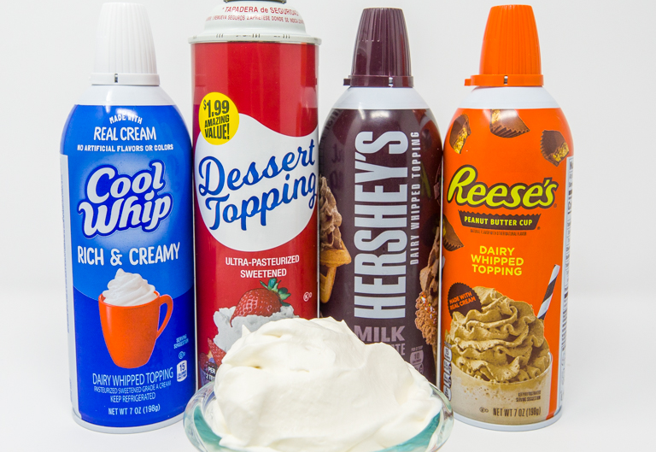
The whipped cream must be placed in a cup

Slide 7
then the whipped cream is transported to the supermarket

Slide 8
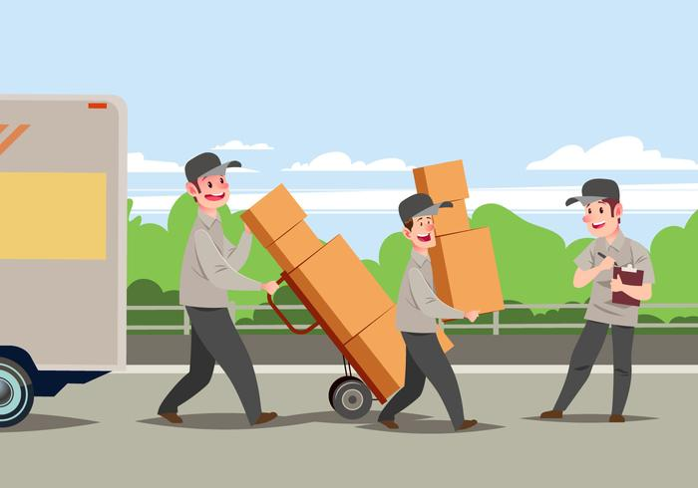
Then the product is transported to the warehouse

Slide 9
whipped cream can then be purchased in supermarket

Slide 10
we put whipped cream in the fridge at home

Slide 11
then the man can use the whipped cream on the cake

Slide 12
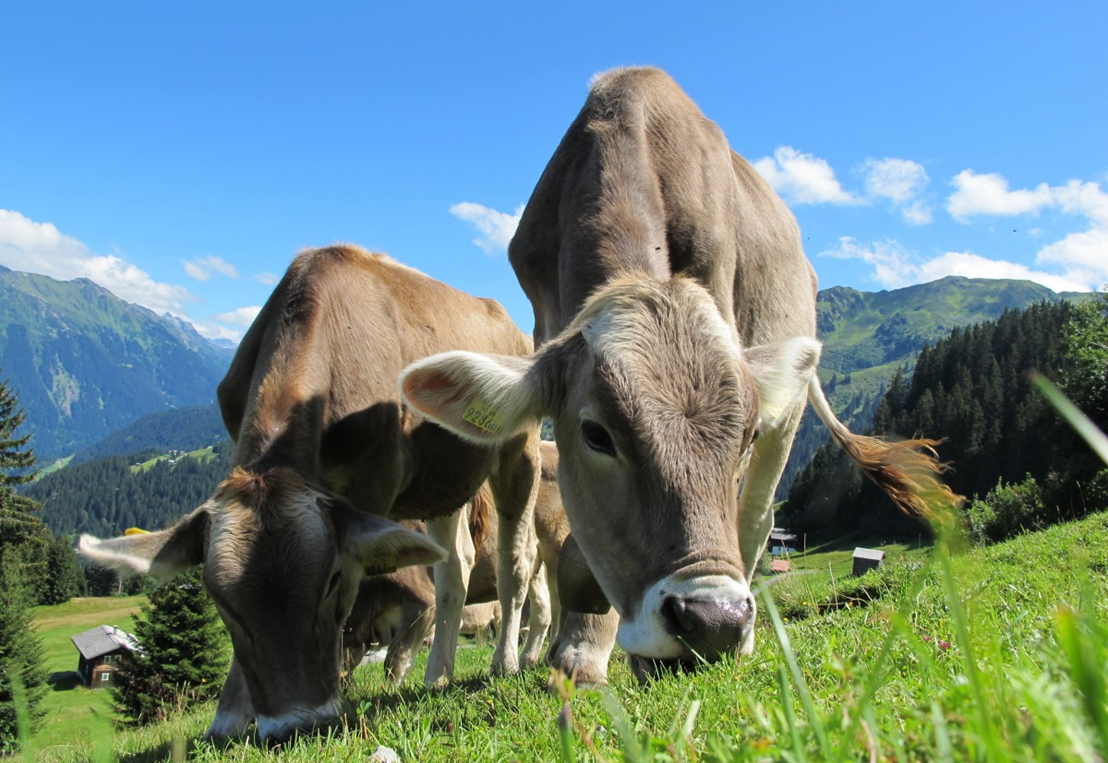
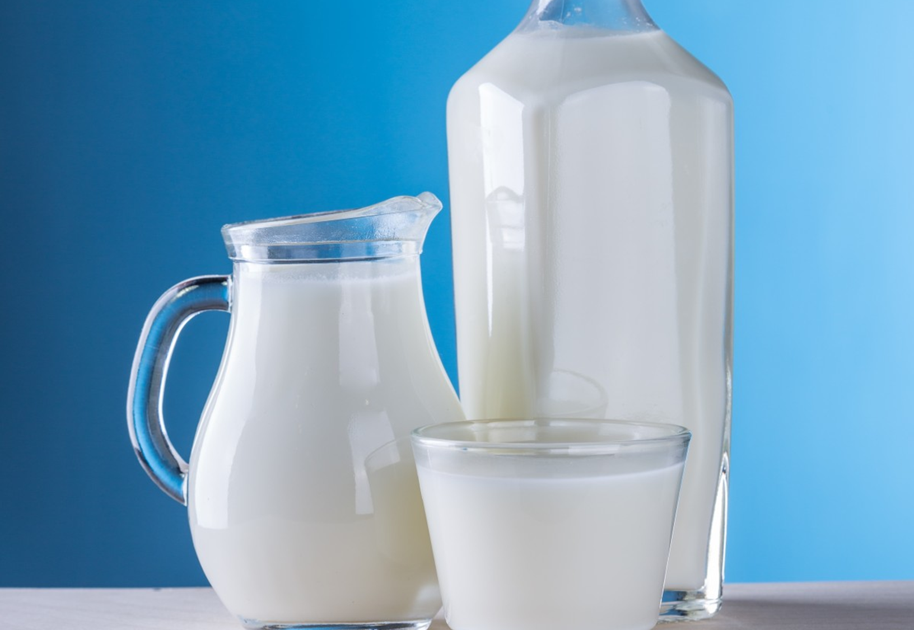
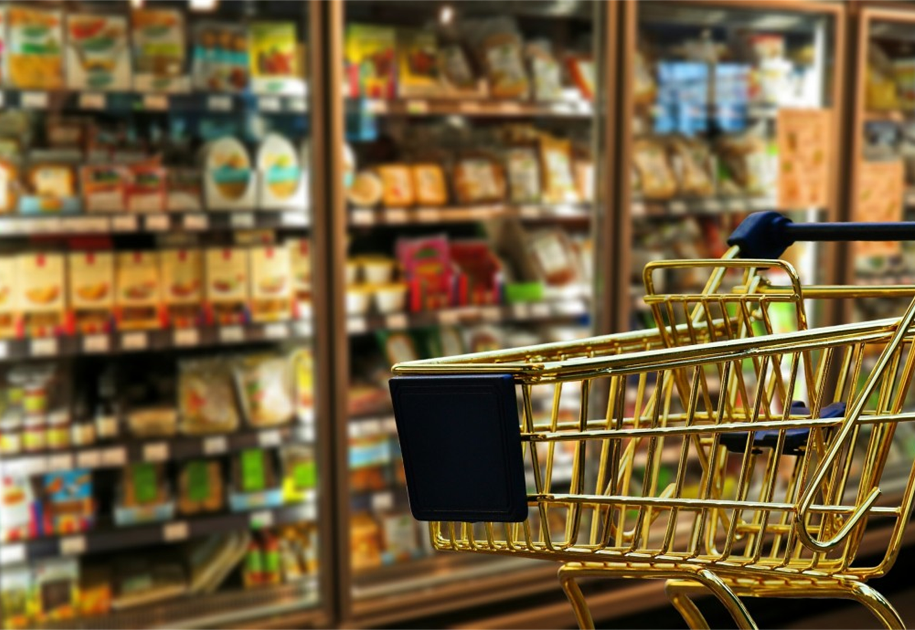
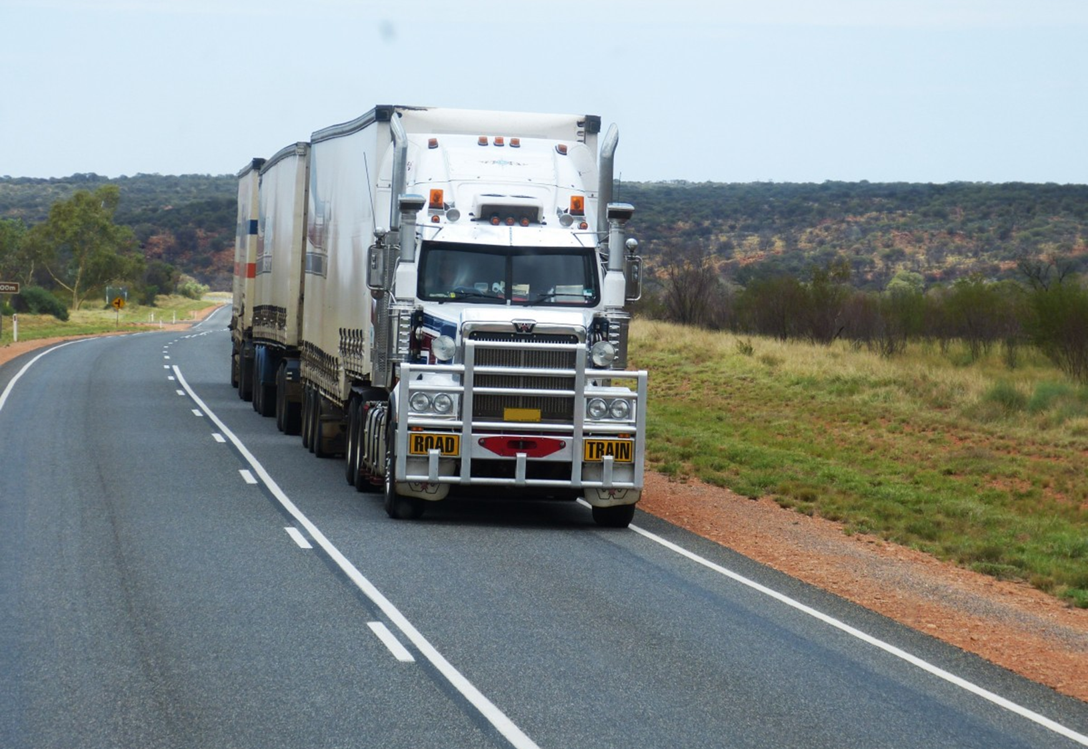
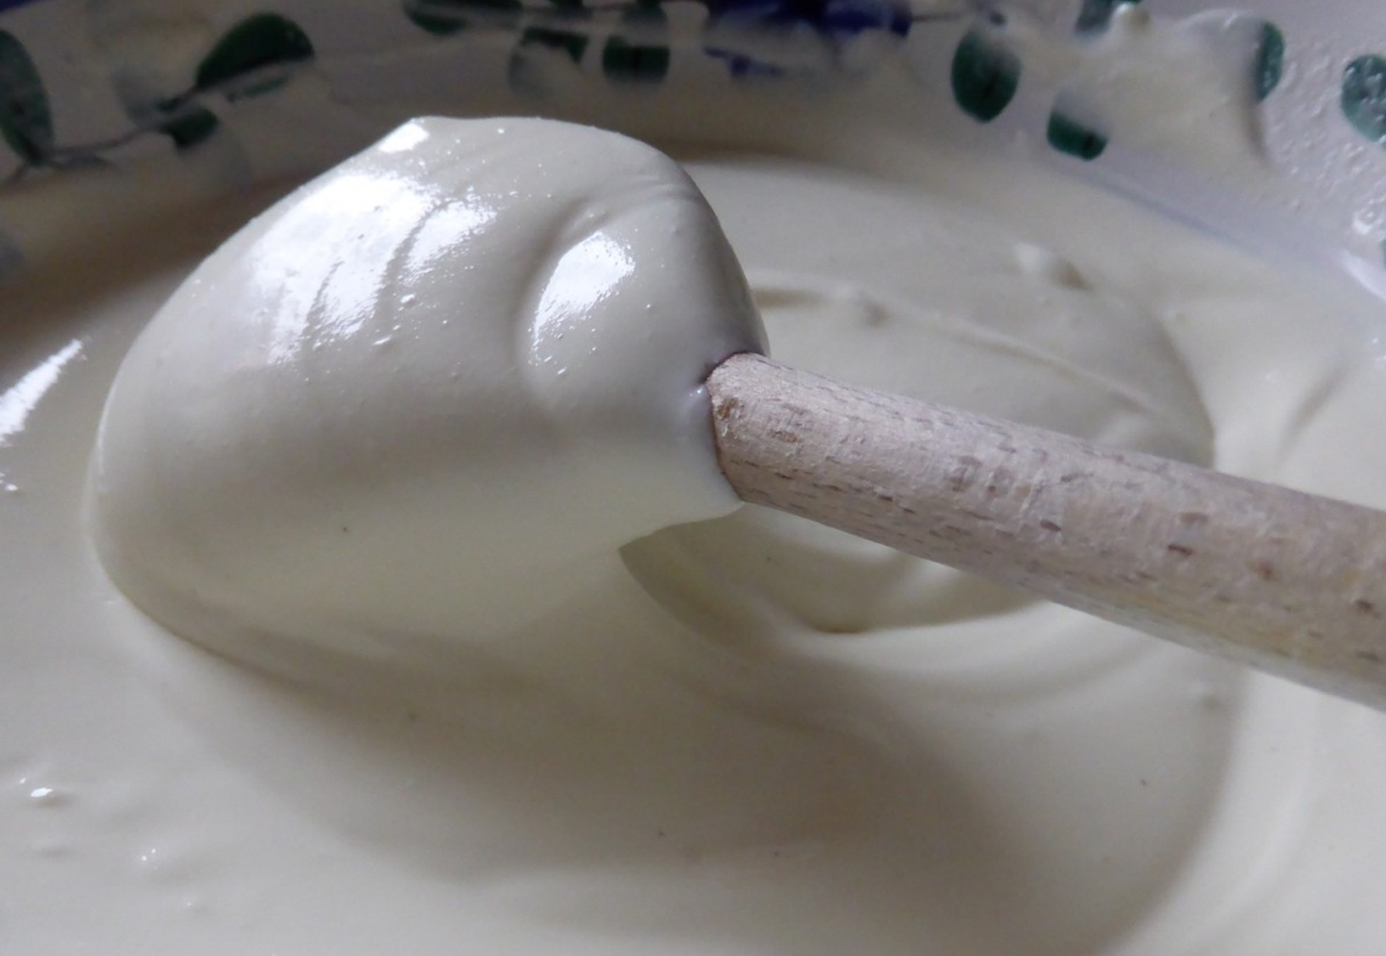
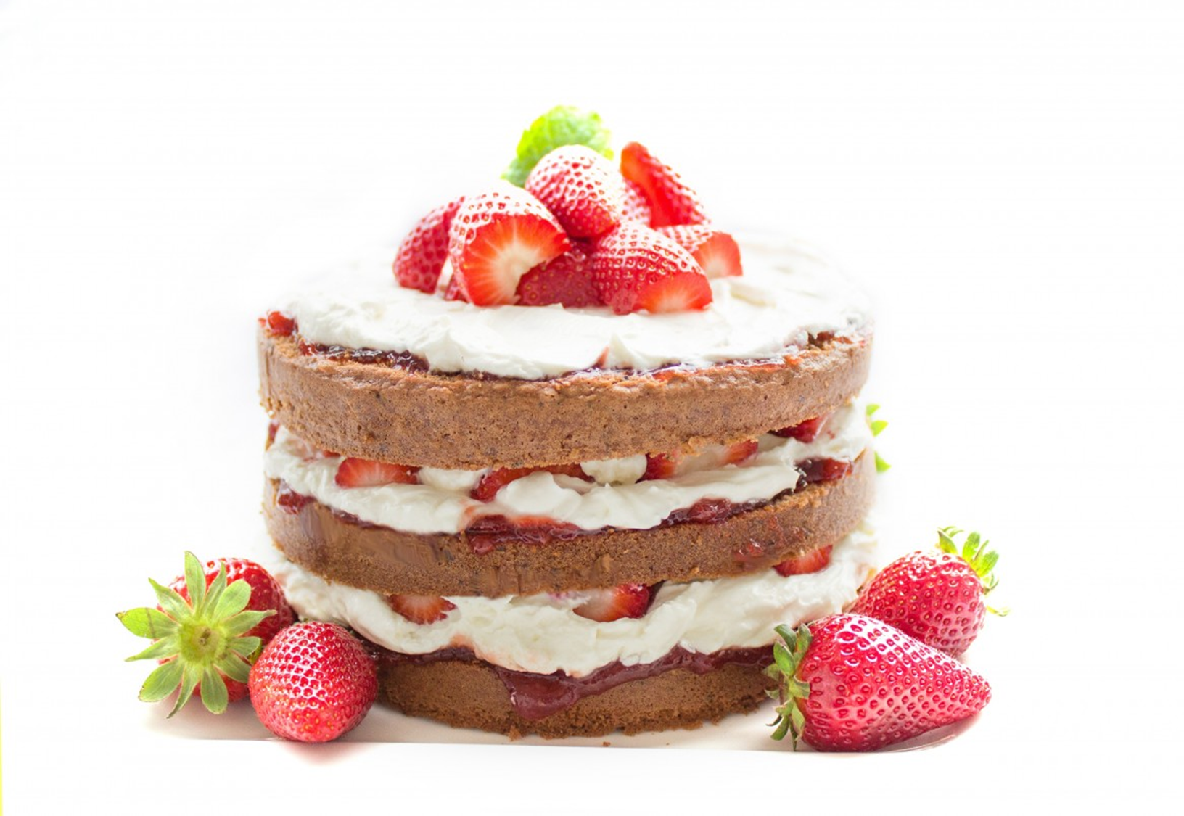
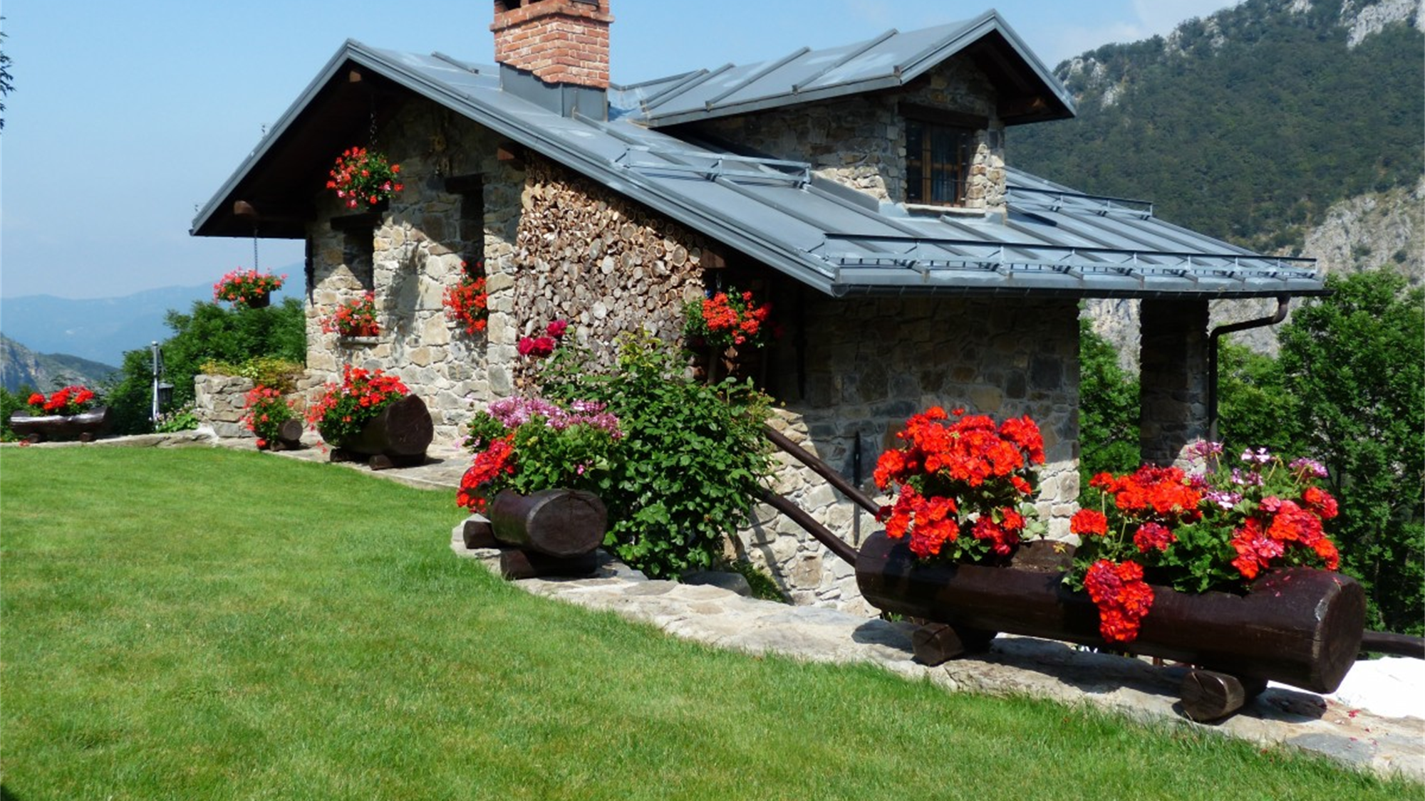
Recapitulation

Slide 13
Sources
https://pxhere.com/cs/photo/1000
https://pxhere.com/cs/photo/1414160
https://pxhere.com/cs/photo/1362675
https://pxhere.com/cs/photo/1086714
https://pxhere.com/cs/photo/772190
https://pxhere.com/cs/photo/1052603
https://pxhere.com/cs/photo/1119894
https://pxhere.com/cs/photo/785280
https://cz2.staticac.cz/foto/vyrobky/3685500/3685301.jpg
https://www.crazy-tutorial.com/ja/wp-content/uploads/2018/11/Movers-Man-Carrying-Cardboard-Boxes.jpg
https://1.bp.blogspot.com/-AG7OoJwGKIc/XWC8pjU4puI/AAAAAAAA6tk/1GFOi2gdW64ql4LrTpHwYaQjSCJ5tBnWACLcBGAs/s1600/WhippedCream-1100.jpg

