Slide 1
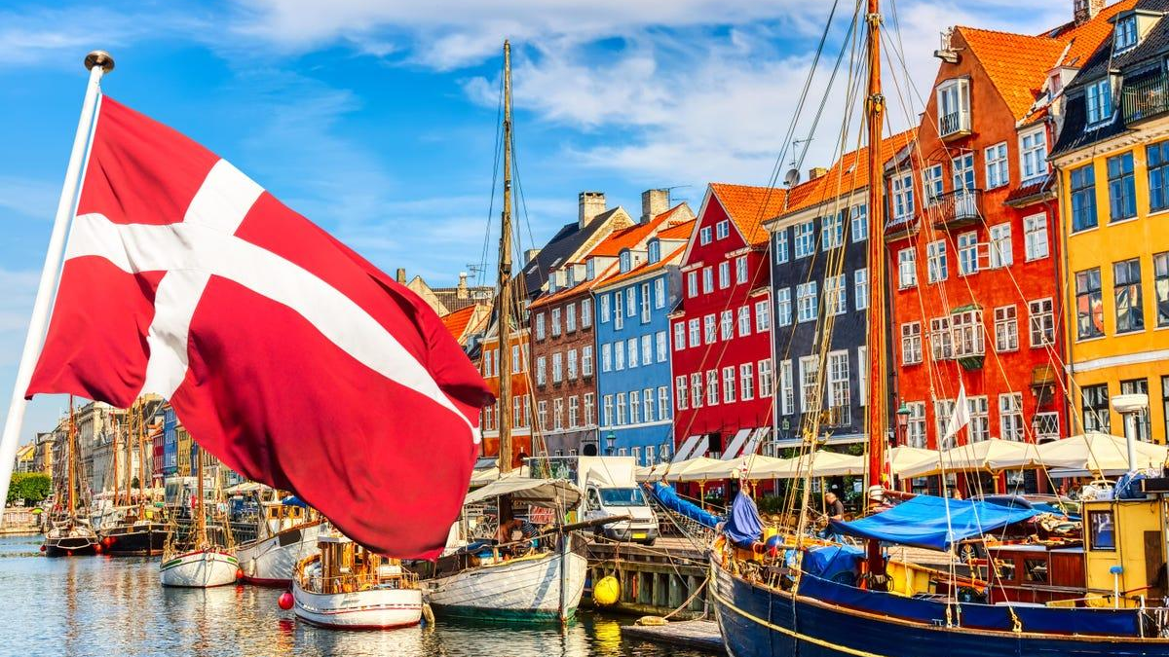
Cartoon
You will get the best experience by clicking “presentate” in the top right
Made by - Frederik & Rasmus,
Denmark

Slide 2
Welcome to Denmark

Slide 3
There once was a boy
My name is Flemming

Slide 4
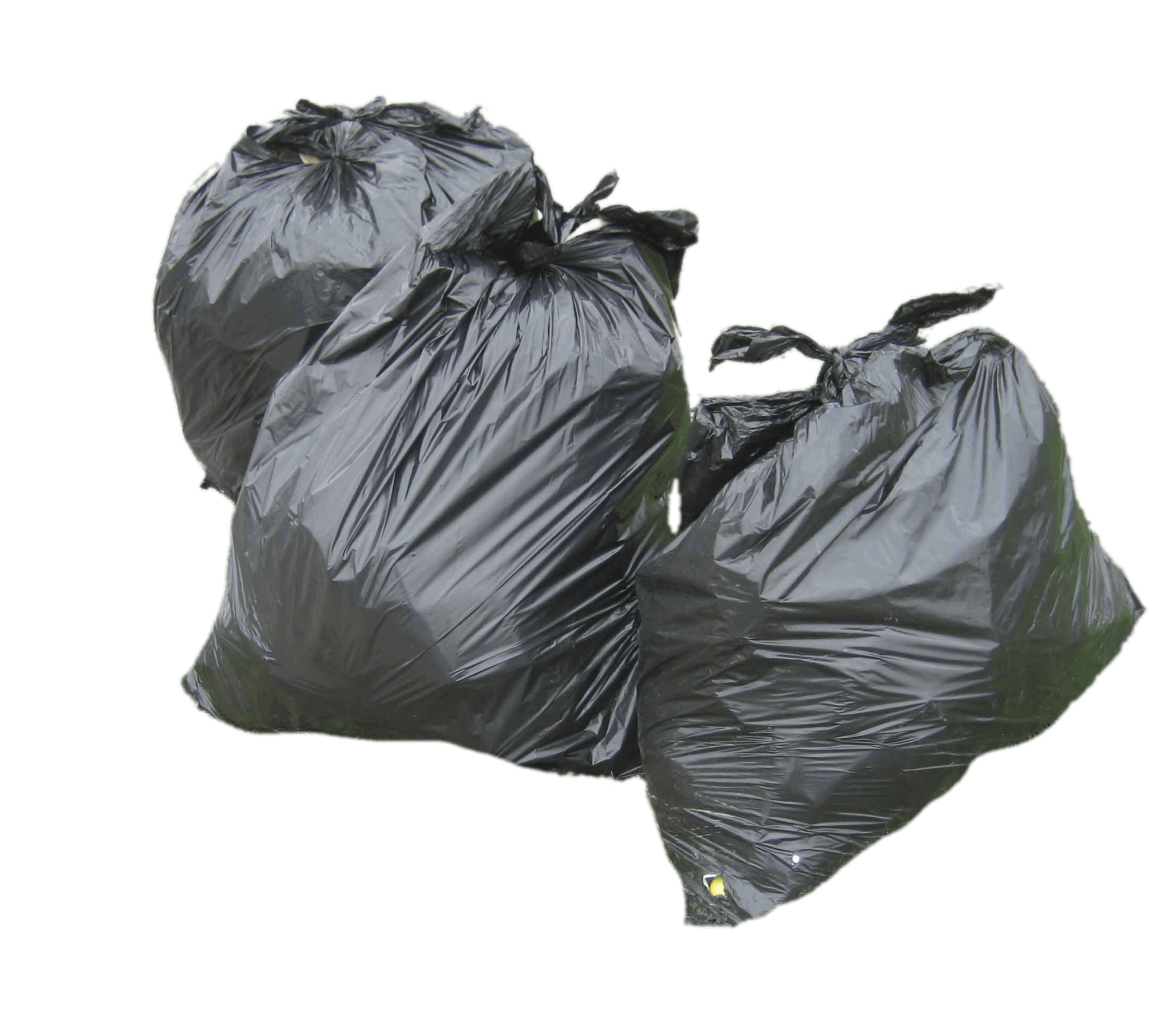
Flemming threw all his garbage in the lake, because he didn't know how to sort the garbage.

Slide 5
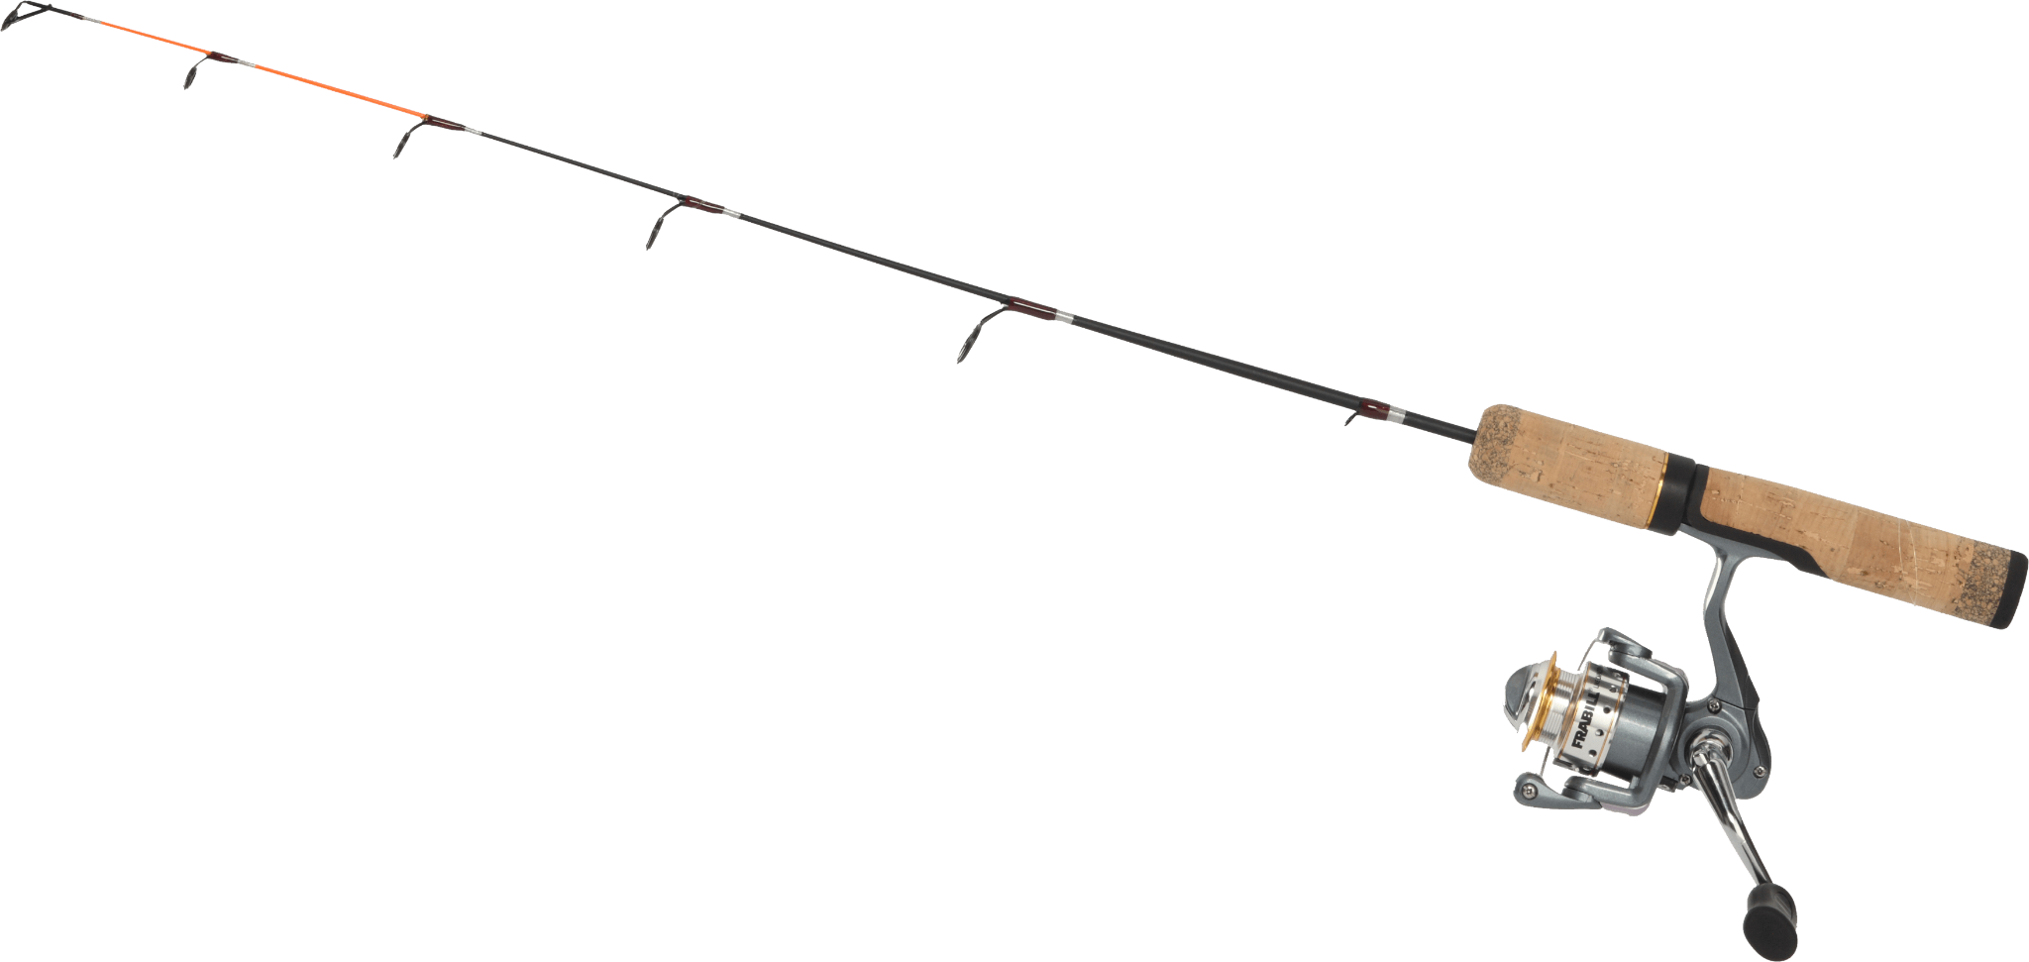
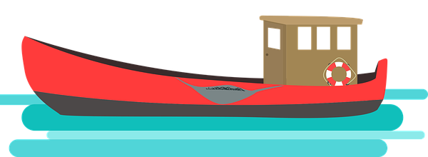
But then another day when Flemming was out fishing
Oh no! The garbage I threw in the lake. What i mess I have made.

Slide 6
Then Flemming begin Sorting his garbage, and recycling

